Slide 1
















ADVANCE STATISTICS ( Week 3)

Slide 2




DSBA CURRICULUM DESIGN
CORE COURSES
DOMAIN APPLICATIONS
FOUNDATIONS
Python For Data Science
Advanced Statistics(Week-3/5)
Financial Risk Analytics
Statistical Methods for Decision Making
Data Mining
Marketing Retail Analytics
Predictive Modelling
Machine Learning
Time Series Forecasting
Data Visualization
SQL

Slide 3


LEARNING OBJECTIVE OF THIS MODULE
ANOVA
EDA
PCA
Proprietary content. ©Great Learning. All Rights Reserved. Unauthorized use or distribution prohibited

Slide 4

LEARNING OBJECTIVES OF THIS SESSION -
Covariance Matrix
Eigen Value
Variance and Cumulative Variance
Scree Plot
Proprietary content. ©Great Learning. All Rights Reserved. Unauthorized use or distribution prohibited

Slide 5








TRY ANSWERING THE FOLLOWING
Can we use PCA for dimensionality reduction?
What is the purpose of using Scree Plot in PCA?
Does different Principal Components orthogonal to each other?
Proprietary content. ©Great Learning. All Rights Reserved. Unauthorized use or distribution prohibited

Slide 6
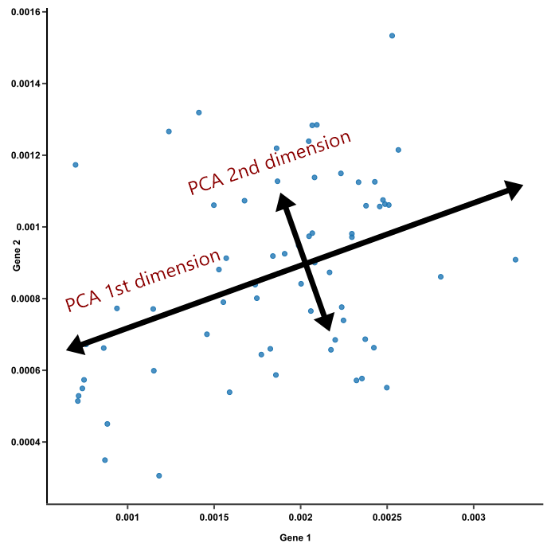
BROAD OVERVIEW
PCA
Proprietary content. ©Great Learning. All Rights Reserved. Unauthorized use or distribution prohibited

Slide 7

PCA to devise IPL’s bidding strategy
Real game begins much before it begins on the pitch.
Indian Premier League (IPL) is a professional Twenty20 championship cricket league in India that has become very popular among cricket fans worldwide. There are several ways that a franchise acquires players. One of these methods is to buy players at player auction. Obviously, franchises pay higher salaries for quality players based on their performance.
Use of PCA-When considering batsmen, the goal in limited-overs cricket, like Twenty20, is to score as many as runs as possible using as few balls as possible. Therefore, variables considered are Runs, Batting Average, Strike Rate, Number of Fours, Number of Sixes, Number of Centuries/Half Centuries etc. But the question is how do we decide which variable is more important and finally can we generate a score that helps us decide which player to bet on?
The answer can be achieved using PCA. Find a linear combination of these variables and use each player’s performance to generate a score.
Reference-http://jse.amstat.org/v21n3/scariano.pdf
Proprietary content. ©Great Learning. All Rights Reserved. Unauthorized use or distribution prohibited

Slide 8

PCA for Designing Survey Questionnaire
Are you asking the right questions?
What single measure describes your overall health?
For example, take questions pertaining to height, weight, smoking habit, exercise routine, blood pressure, diabetes, heart disease etc in a healthcare survey. Individually, the responses to these questions are too specific to say much about your overall health. But taken together, they can provide a more comprehensive measure of your wellbeing, which is the common factor that researchers are truly interested in.
Instead, many researchers will ask a series of health-related questions and perform a factor analysis, which generates a standardized score of health. It helps us find out whether variables (or in the case of surveys, questions) are correlated with one another or with some other variable or concept. Statisticians call these related variables common factors.
We can determine the relationships between groups of variables by lumping together the ones that are that are strongly correlated, making them into common factors. This is the basis of factor analysis, which is often used in the fields of psychology, health, and political science.
https://www.surveygizmo.com/resources/blog/factor-analysis/
Proprietary content. ©Great Learning. All Rights Reserved. Unauthorized use or distribution prohibited

Slide 9
Case Study- (Silhouette of Vehicles)
The data contains features extracted from the silhouette of vehicles in different angles. Four "Corgie" model vehicles were used for the experiment: a double decker bus, Cheverolet van, Saab 9000 and an Opel Manta 400 cars. This particular combination of vehicles was chosen with the expectation that the bus, van and either one of the cars would be readily distinguishable, but it would be more difficult to distinguish between the cars.
The purpose is to classify a given silhouette as different vehicle, using a set of features extracted from the silhouette.
Attribute Information:
All the features are geometric features extracted from the silhouette.
All are numeric in nature.
Proprietary content. ©Great Learning. All Rights Reserved. Unauthorized use or distribution prohibited

Slide 10








ANY QUESTIONS
?

Slide 11

HAPPY LEARNING

